Slide 1
H26：Live2D Video Chat
LU, Junxian 20626238 jluay@connect.ust.hk
ZHANG, Zidi 20493849 zzhangcy@connect.ust.hk

Slide 2
Project objectives
Create a P2P video tool using Live2D
Capture human expression data from normal camera and translate to Live2D expression
Low network traffic and latency by transferring only Live2D data
[Future] Support group chat
[Future] Allow online user search and chat

Slide 3
Features incorporated
GUI
Main window
Setting
Computer vision
Live2D display

Slide 4
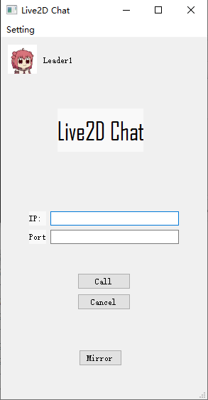
Main window
Profile and Name
Setting
Call area
Selfie

Slide 5
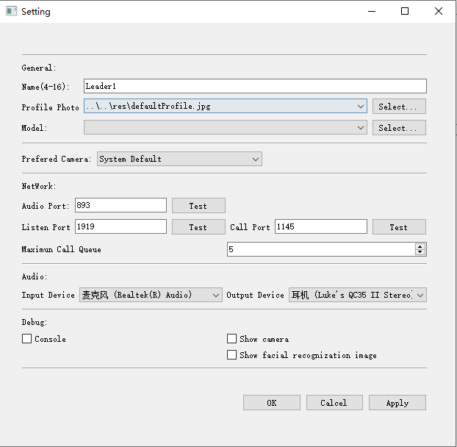
Setting
Default values
Device settings
Debug Settings

Slide 6
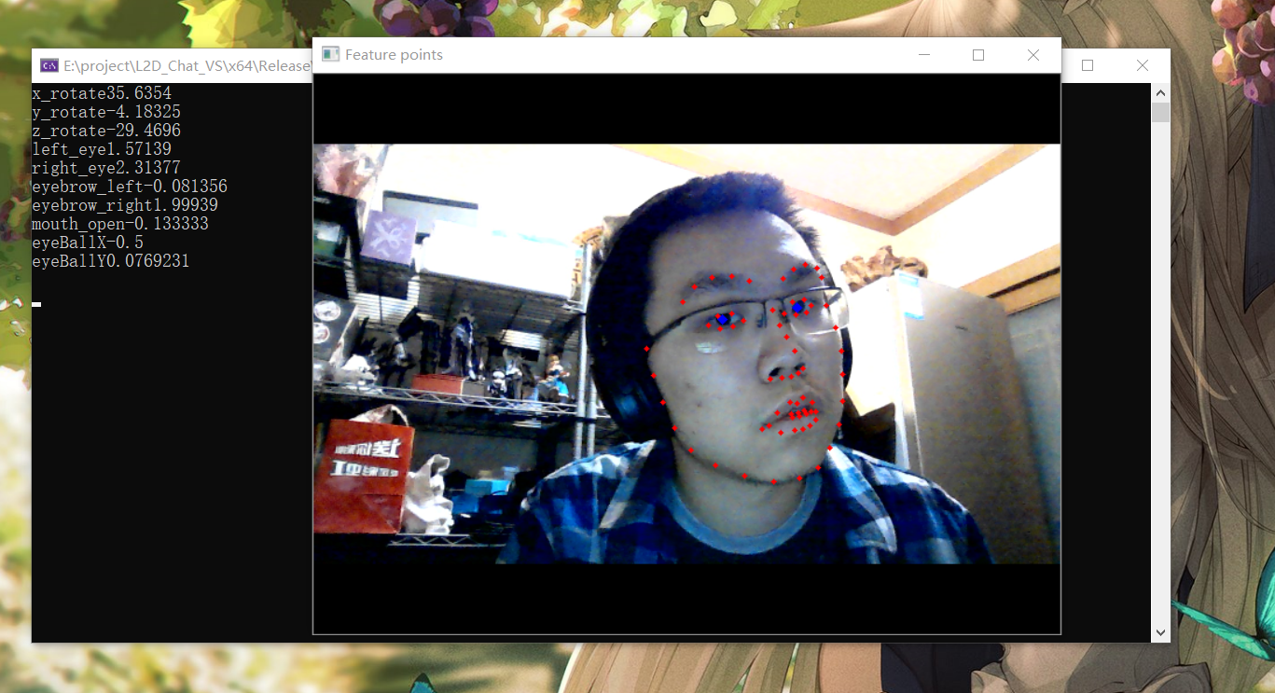
Computer vision

Slide 7
Facial recognition
(Not shown)
Facial Landmark detection
(Red dots)
Iris detection
(Blue dots)

Slide 8
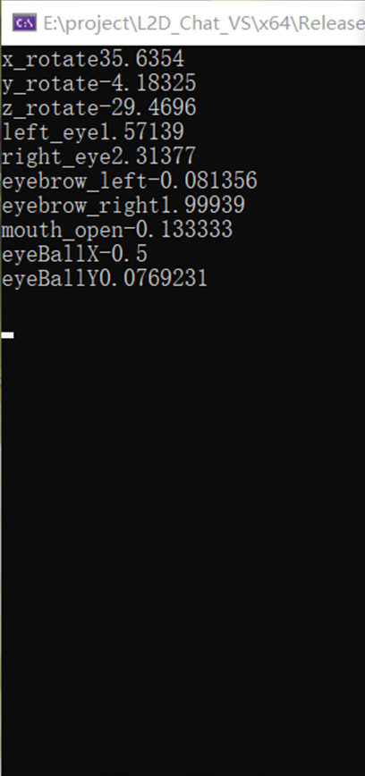
Parse to Live2D motion data
Implicitly translate dots into these data that Live2D reads

Slide 9
Live2D

Slide 10
OOP design
Widely used Class and Object (Almost everything)
Single instance Classes for classes that should be unique (e.g. Setting, Network, Detection)

Slide 11
Data structures used
We didn't implement any data structures from scratch. We make use of the excellent libraries provided by the STL and Qt, which contain complex data structures. And that is the point of abstraction, the very key to the art of programming.

Slide 12
External libraries used
QT (GUI, Socket, UUID generate)
OpenCV (Camera read, Iris detection)
Dlib (Facial recognition, Facial Landmark detection)
OpenGL (Live2D rendering)
Cubism (Live2D close source library )
Json with modern C++ (Json data structure)

Slide 13
Conclusion
In this project, we explore wide range to technic. During development, we tried different approach to the target and select the best to apply. Though didn’t produce a perfect product, we were able to setup good basic and structure for future updates.

